Slide 1
EDAB Update
NEFSC
17 October 2019

Slide 2
Outline
Milestones
Plans for FY20
Questions

Slide 3
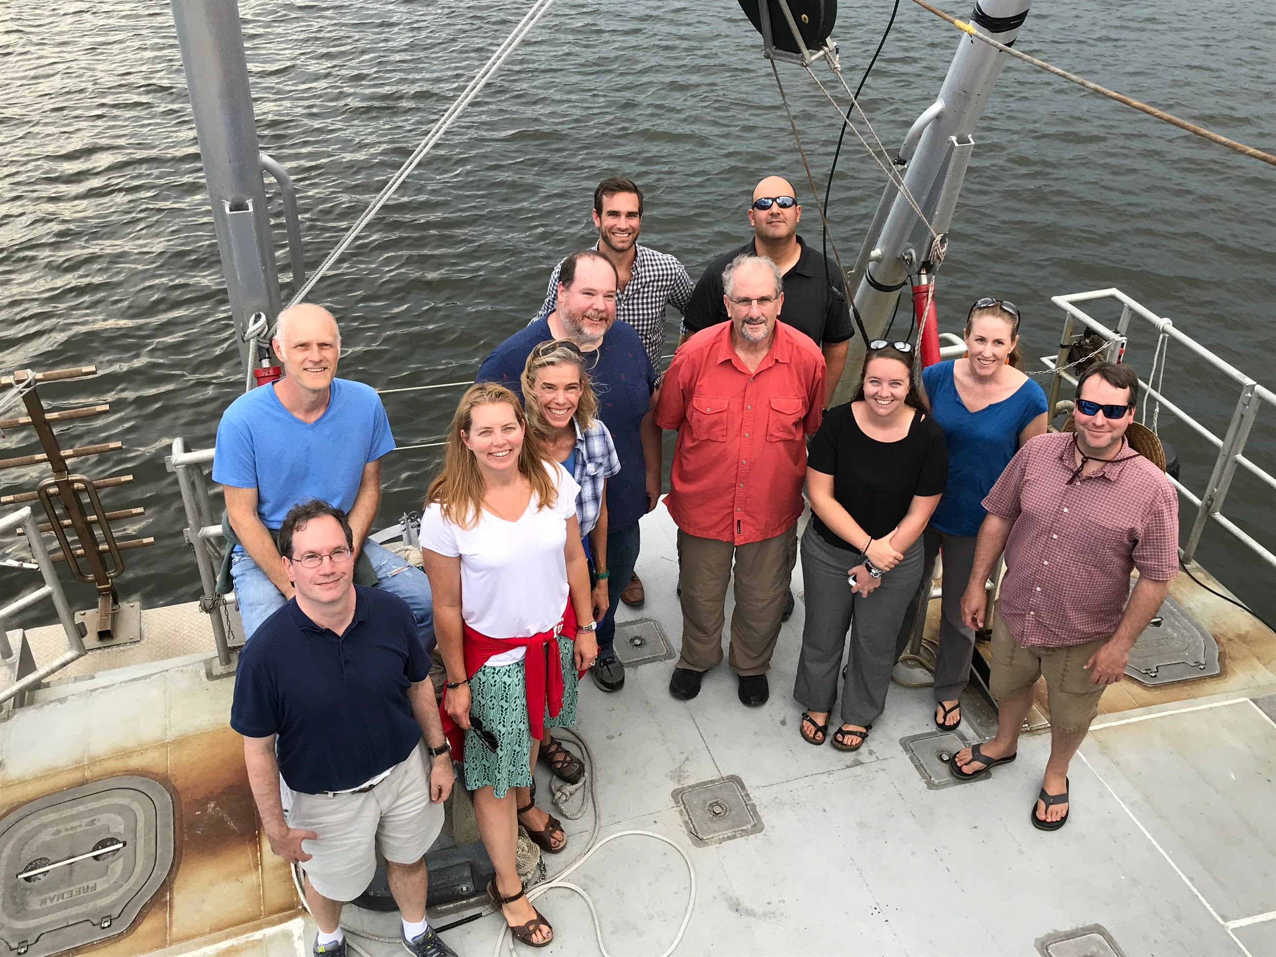
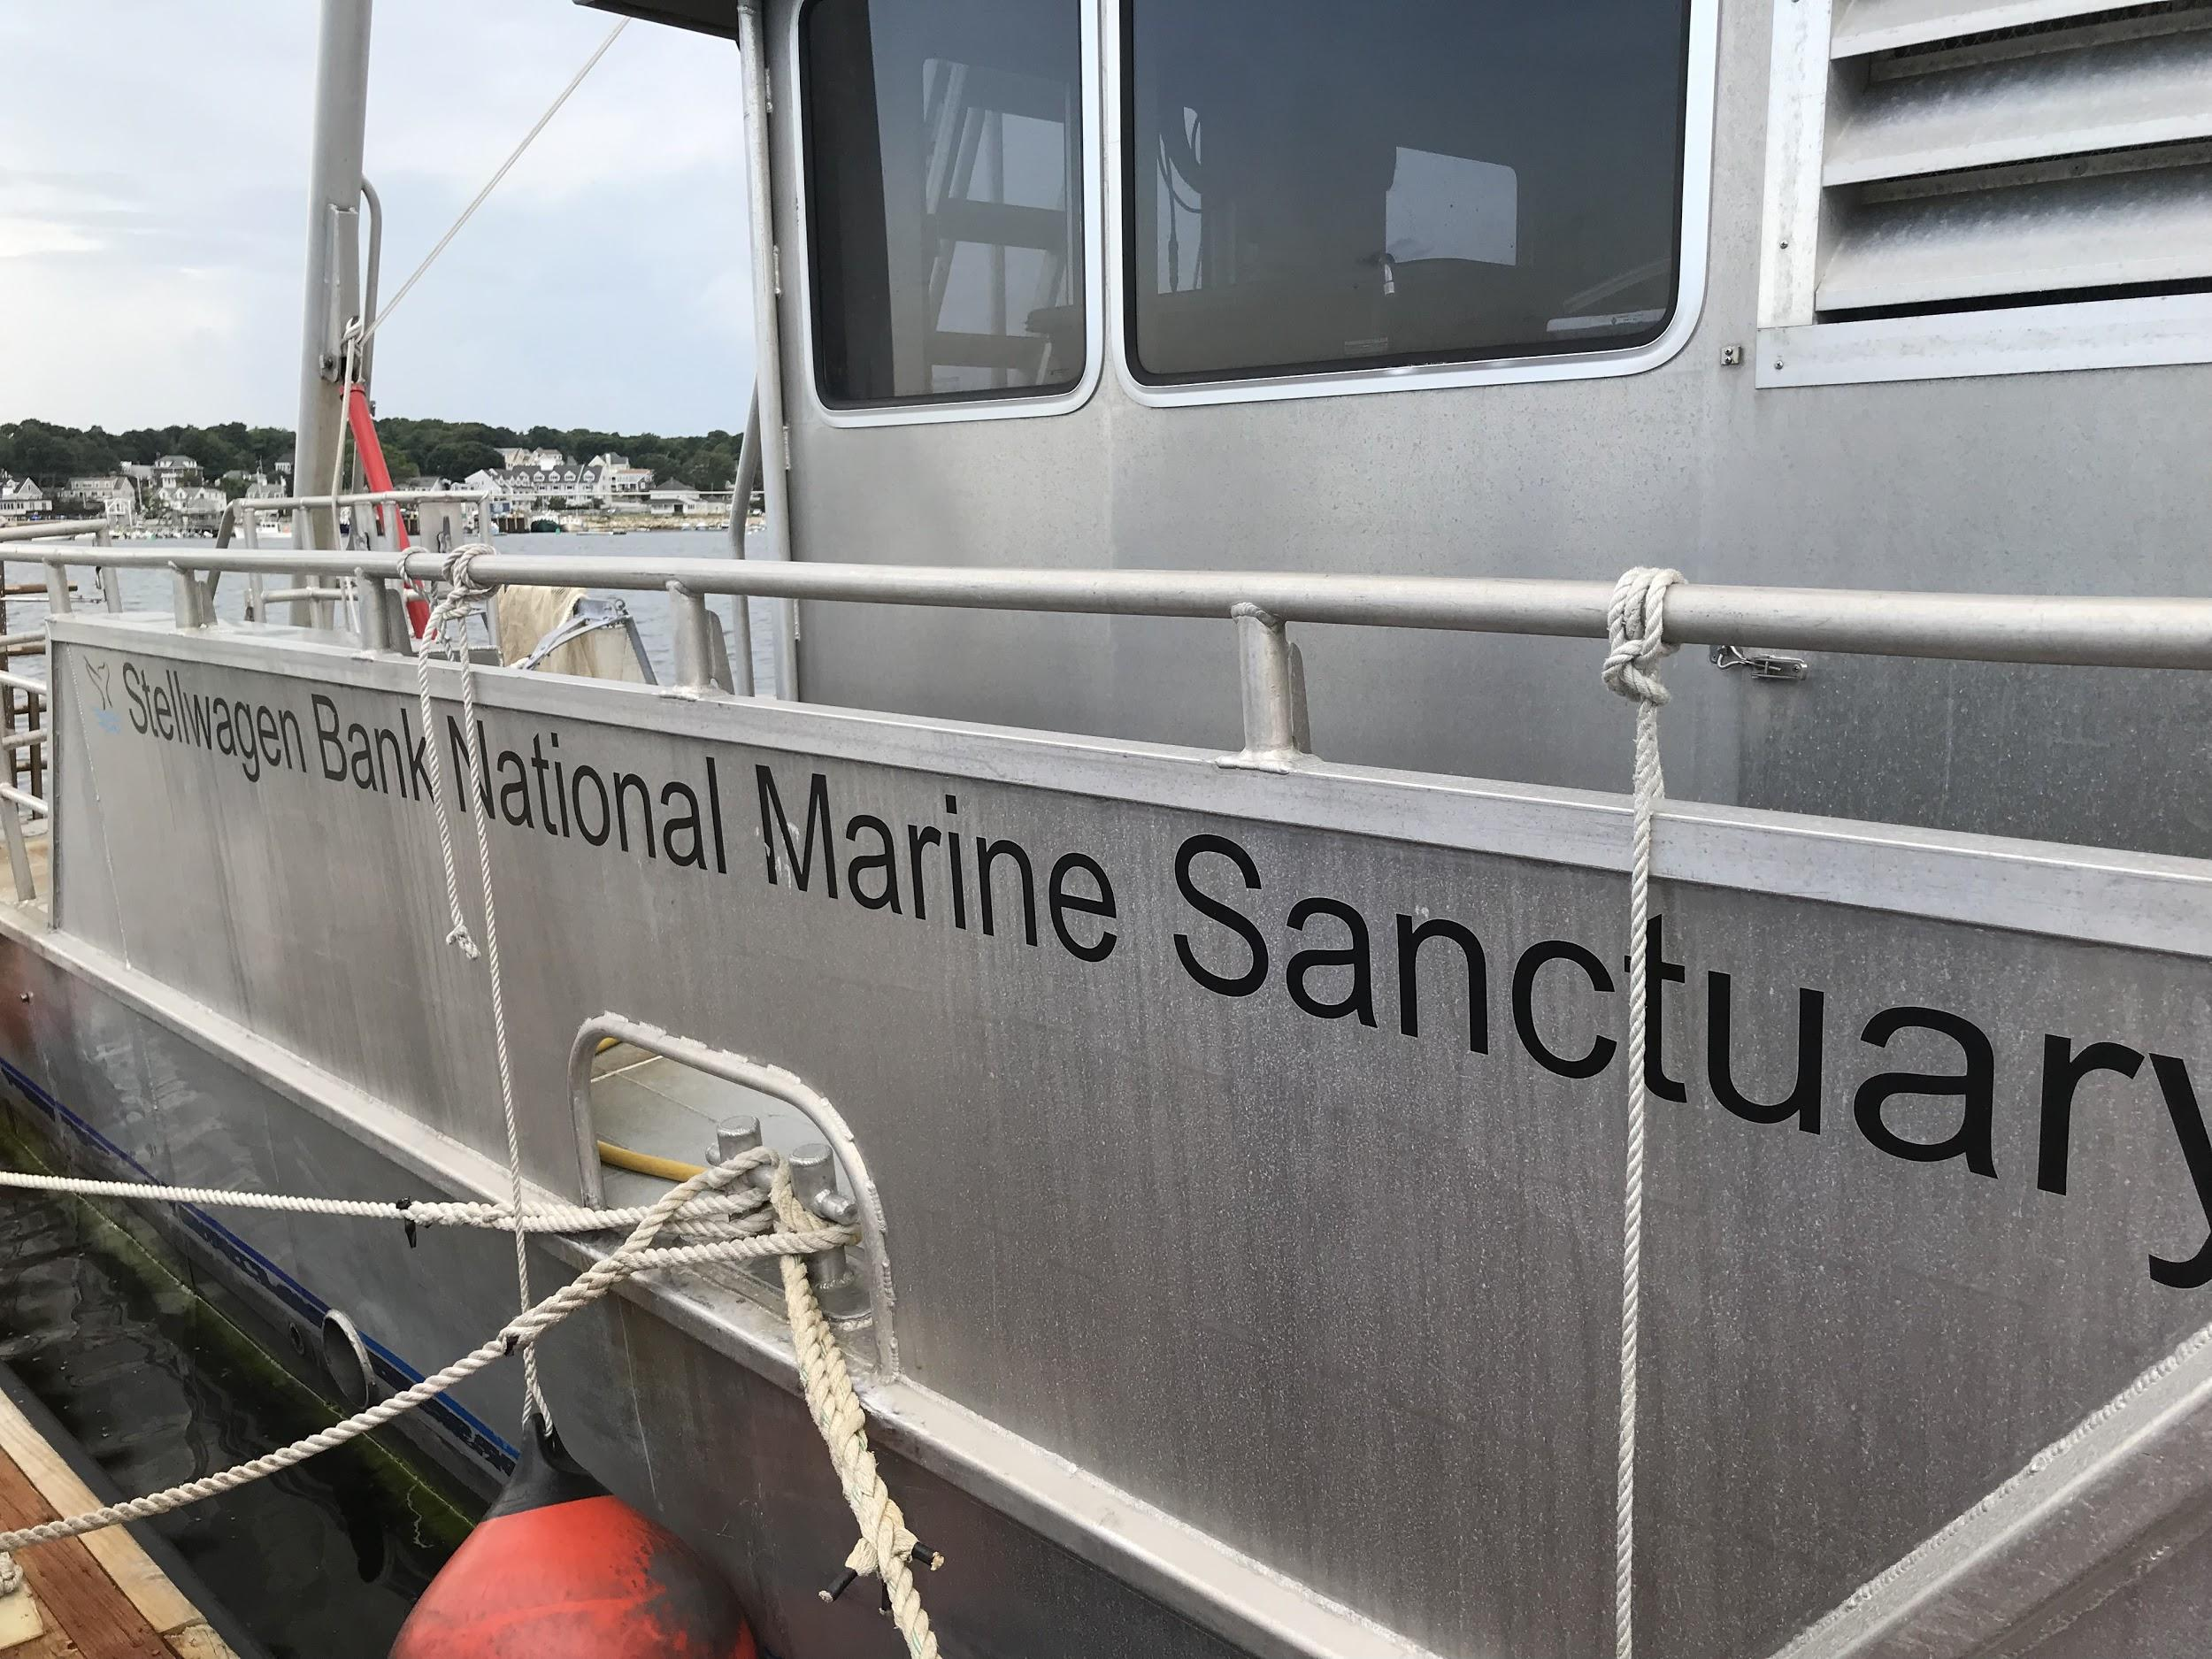
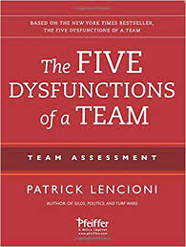
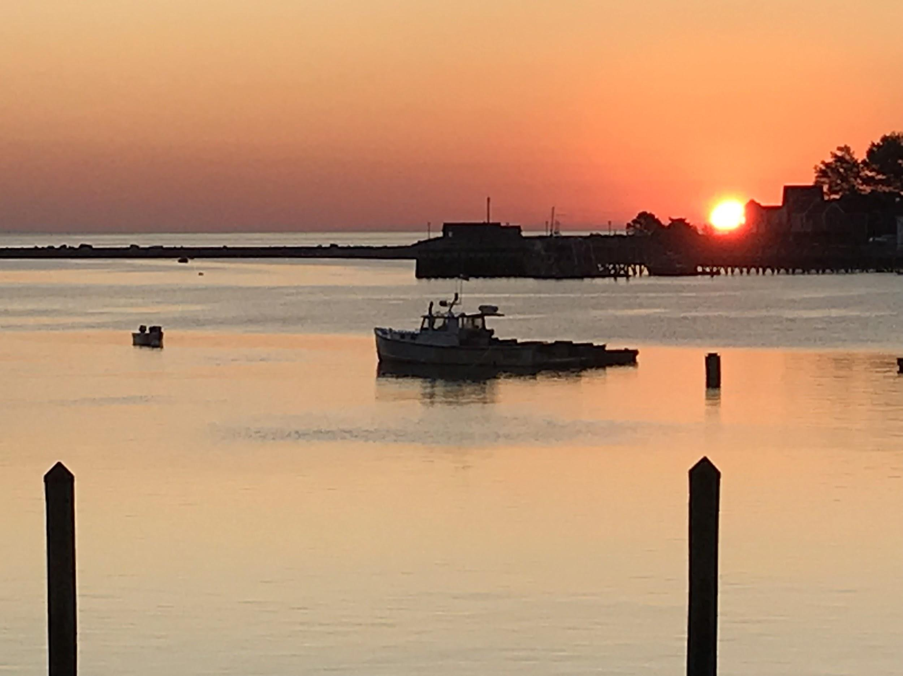
Milestones
August Retreat
How we work

Slide 4
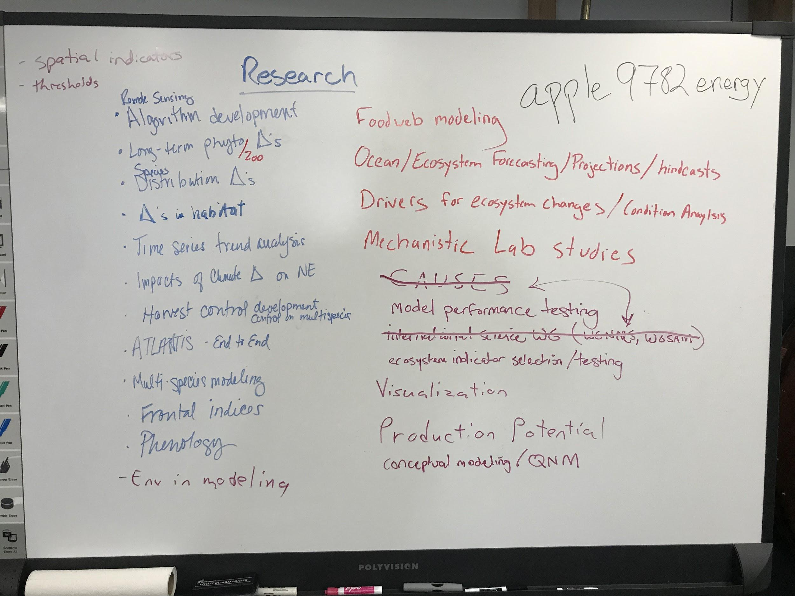
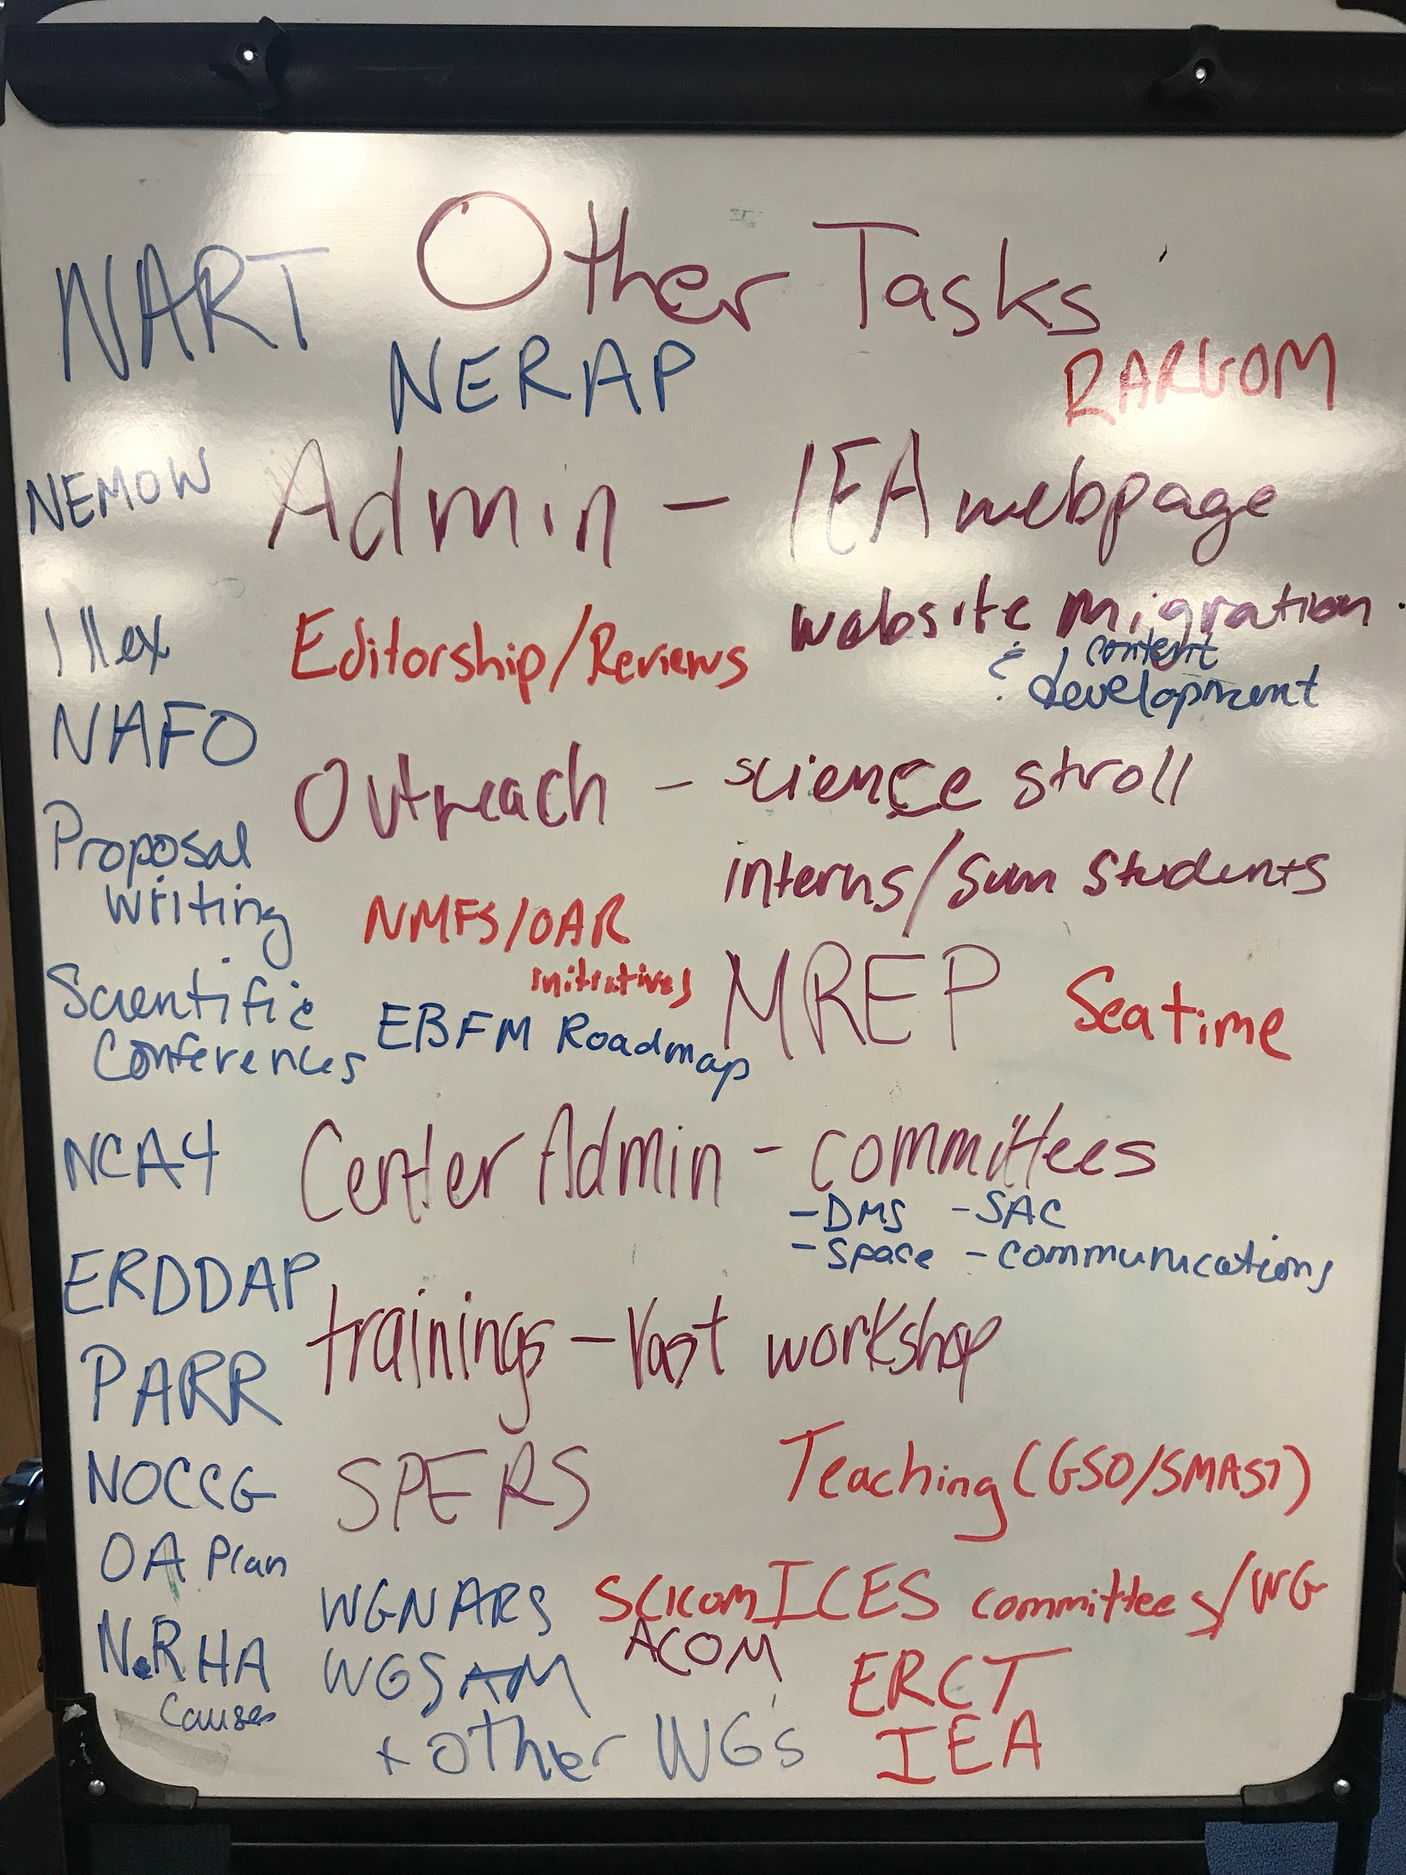
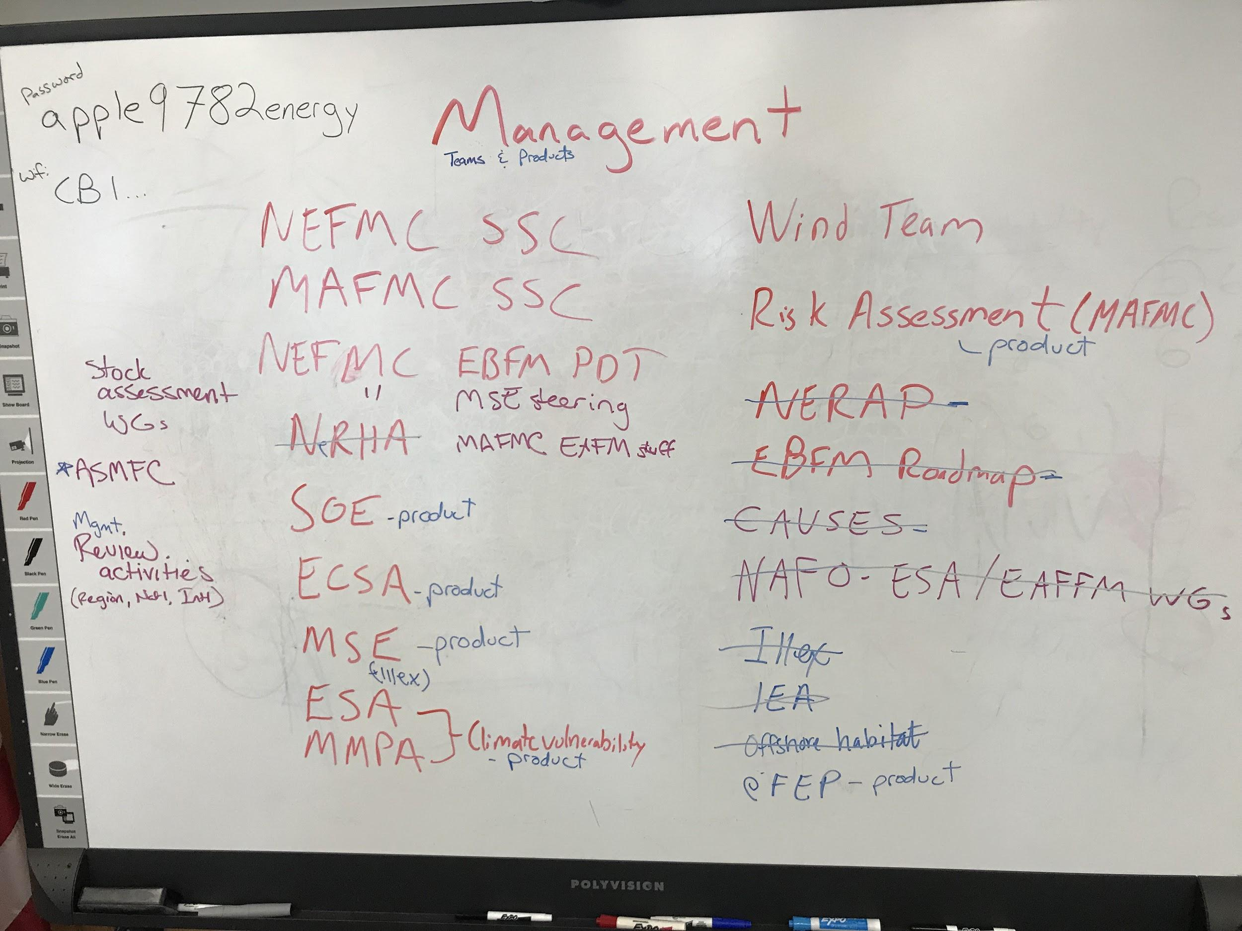
Milestones
August Retreat
Mission Statement

Slide 5
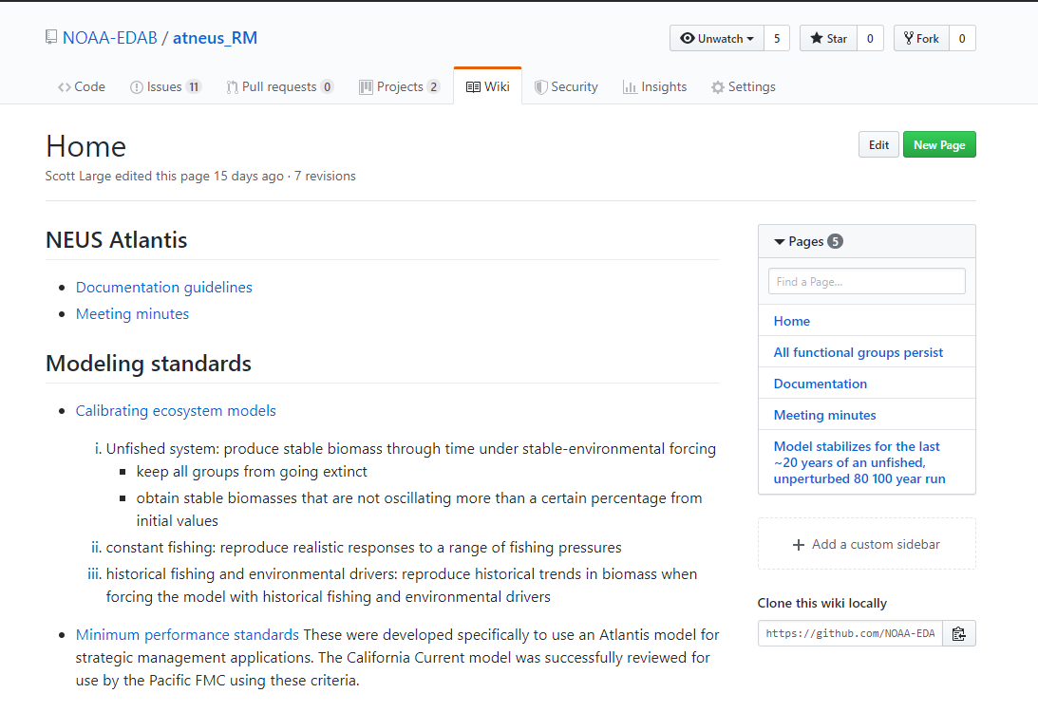
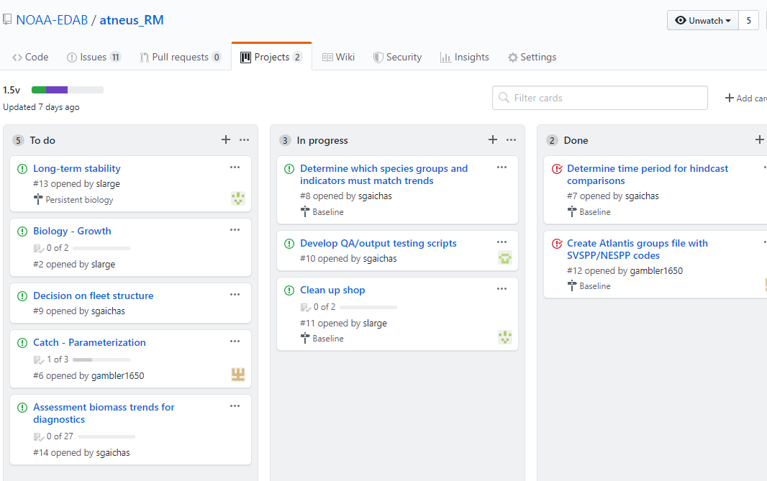
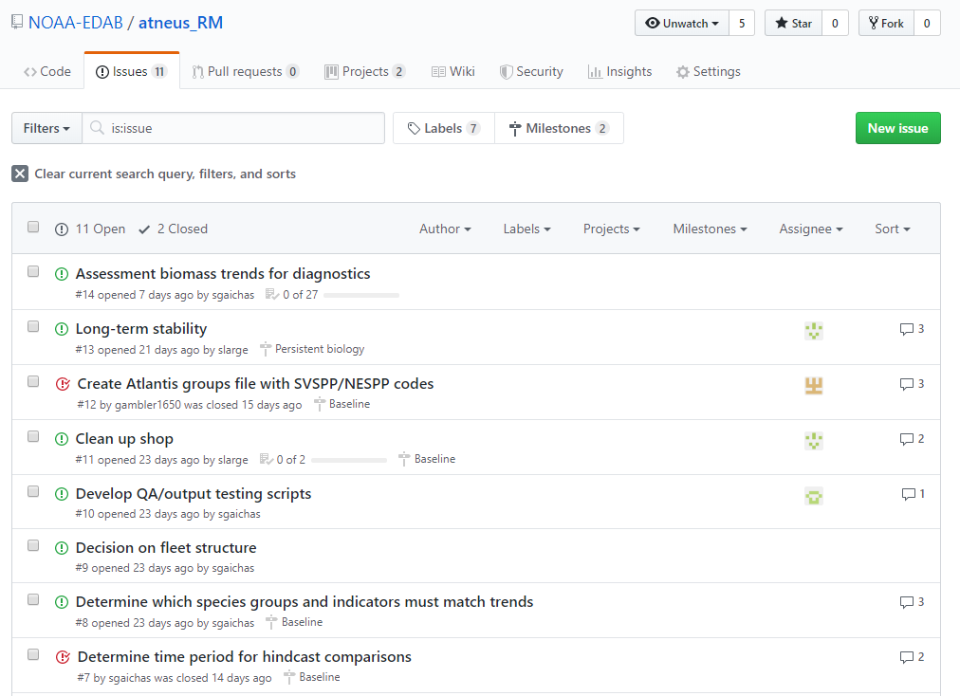
Milestones
Models
Project Management tools to organize Atlantis development

Slide 6
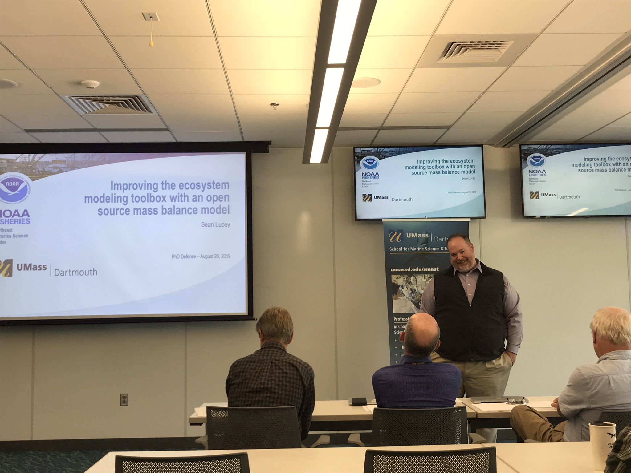
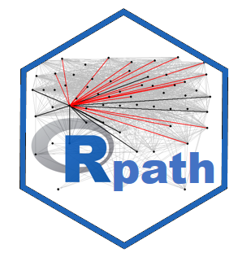
Milestones
Models
Rpath

Slide 7
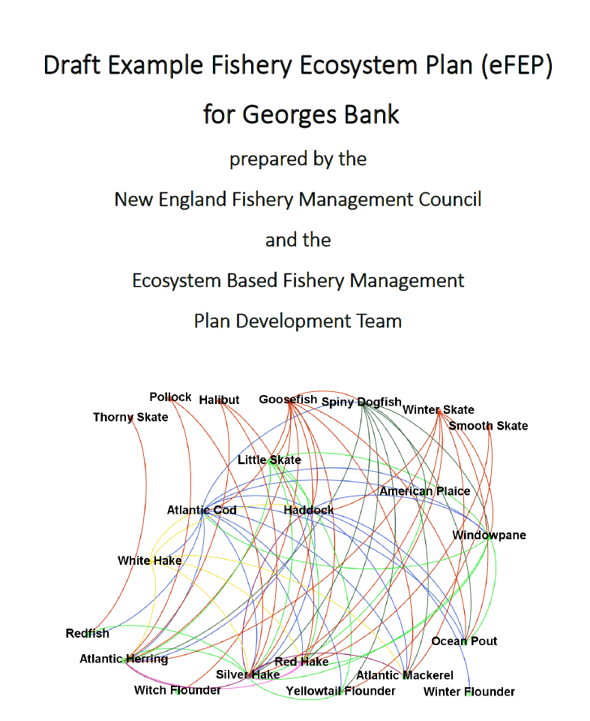
Milestones
Management
eFEP

Slide 8
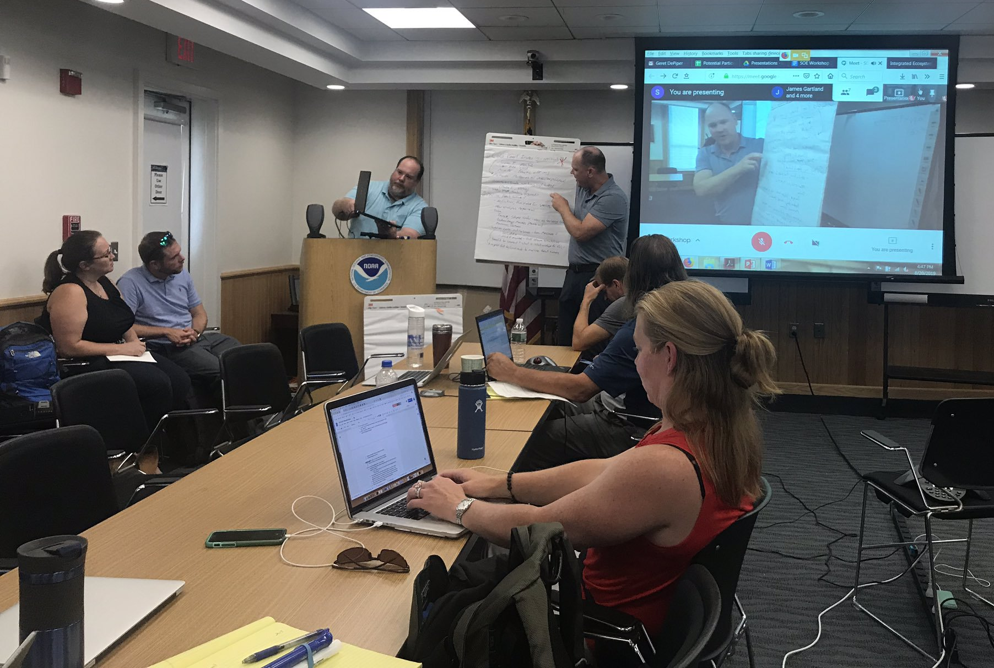
Milestones
Management
State of the Ecosystem Workshop

Slide 9
Plans for FY20
Openscapes Workshop https://www.openscapes.org/
“Better science in less time, together” (early 2020)
Website update
prepare for MSE(s)
Improve linkages within READ
Seal modeling
Habitat modeling
IEAs
...

Slide 10
Mission statement
The Ecosystem Dynamics and Assessment Branch consists of an interdisciplinary group of researchers with backgrounds in fisheries science, oceanography, and climate science. We use open-science principles to develop and apply ecosystem and statistical models to integrate information on biological, climate, oceanographic, and human-related activities to evaluate the effects on ecosystem structure and function. We work collaboratively across the Center and with a broad suite of partners to synthesize ecosystem information to inform living-marine resource management and support ecosystem-based fisheries management in the Northeast United States.

